Slide 1

A New Approach of Image Contrast Enhancement based on Entropy Curve
Submitted By:
Abhijit Paul, 1201
Shaed Shad Ullah Galib, 1206
Rupali Tasnim Samad, 1208

Slide 2
Table of Contents
Introduction
Progress
SRS
Code
Evaluation
Done and Todos

Slide 3

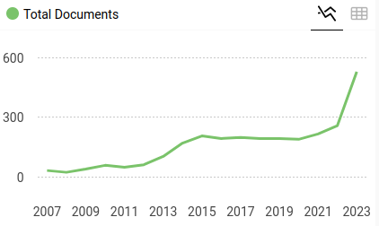
Introduction
Journal: Signal, Image and Video Processing, Q2
From: IIITDM Jabalpur, Nov 2023

Slide 4
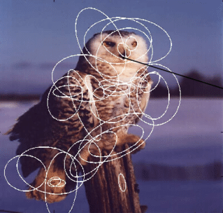
Introduction > Entropy Curve vs Histogram
Paper Title: A new approach of image contrast enhancement based on entropy curve
Global information includes overall intensity distribution, and large-scale features.
Local Information includes texture, edges, and fine details in specific regions of the image.

Slide 5
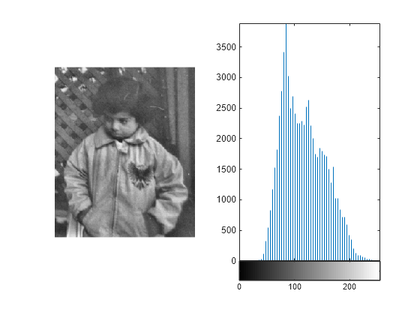
Introduction > Entropy Curve vs Histogram (Contd)
Paper Title: A new approach of image contrast enhancement based on entropy curve
Histogram only considers global information! So the authors introduce entropy as it considers both local and global information.

Slide 6
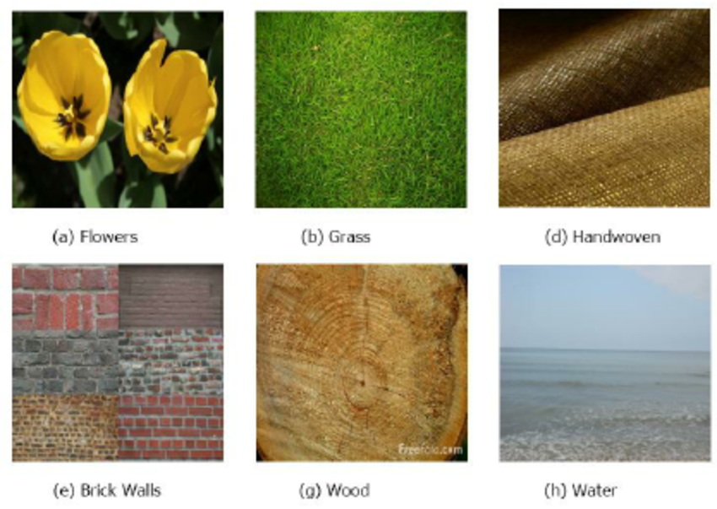

Introduction > What is Entropy in Image?
The entropy measures the information content or randomness of an image based on its pixel value distribution
Higher entropy indicates more randomness or detail (e.g., a textured image)
Lower entropy suggests uniformity (e.g., a smooth image).

Slide 7

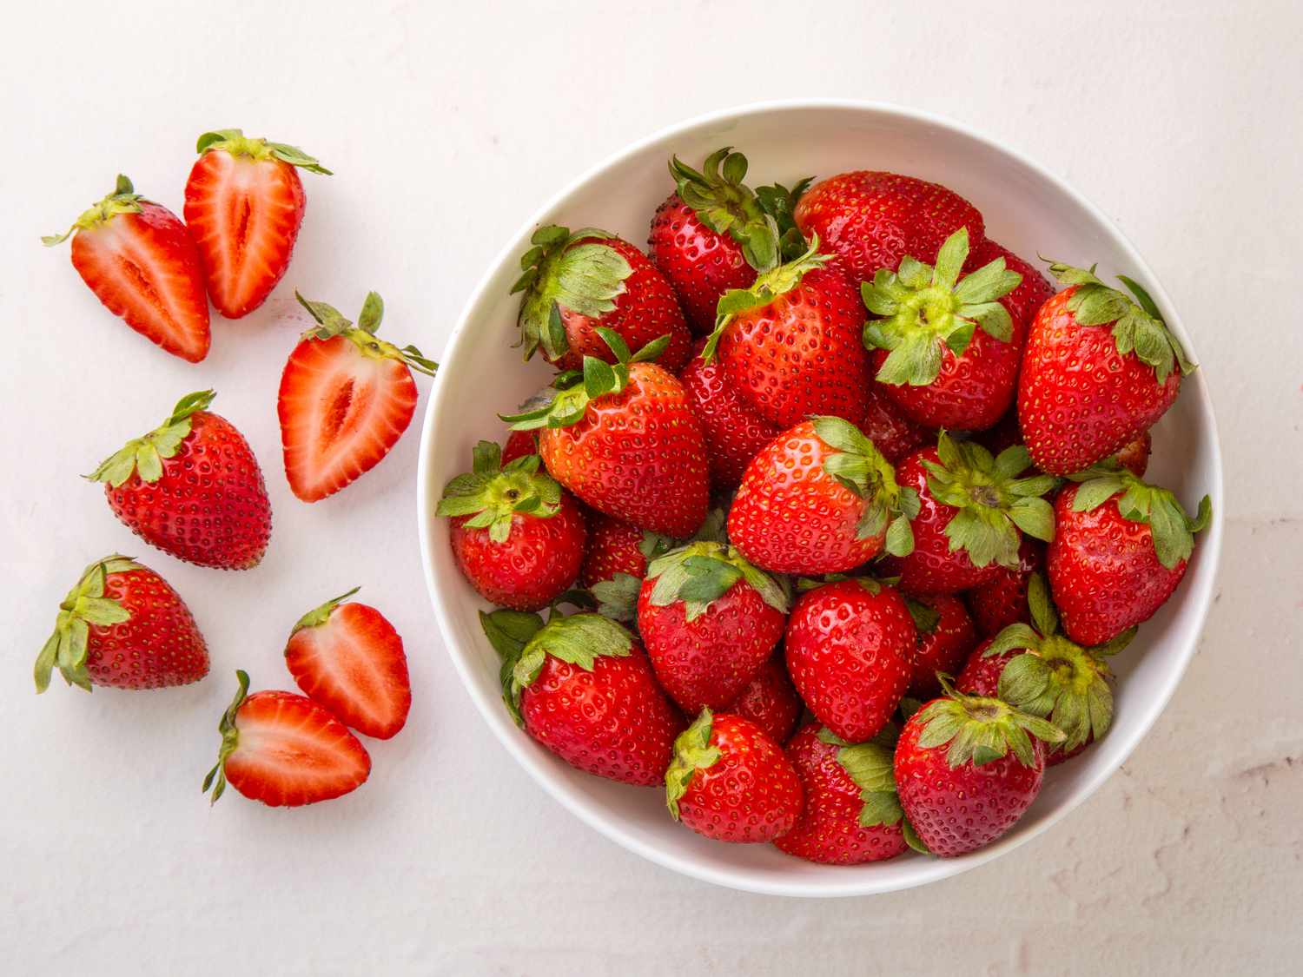
Introduction > What is Entropy in Image? (Contd.)
The entropy measures the information content or randomness of an image based on its pixel value distribution
→Higher entropy indicates more randomness or detail (e.g., a textured image)
→Lower entropy suggests uniformity (e.g., a smooth image).

Slide 8
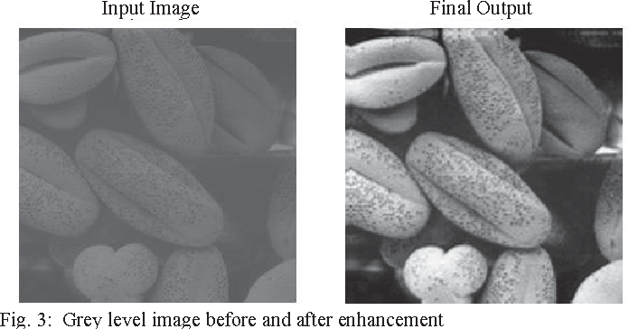
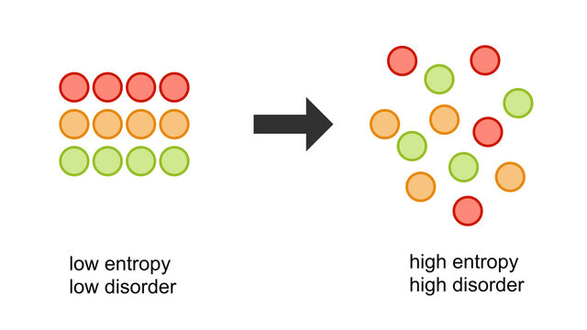
Introduction > What is this paper about?
A novel method for Image contrast enhancement
using Entropy
Unlike papers that forces accuracy using preprocessing, this paper performs 0 preprocessing. Such amazing performance (27 PSNR) with a novel mathematical approach

Slide 9


Slide 10
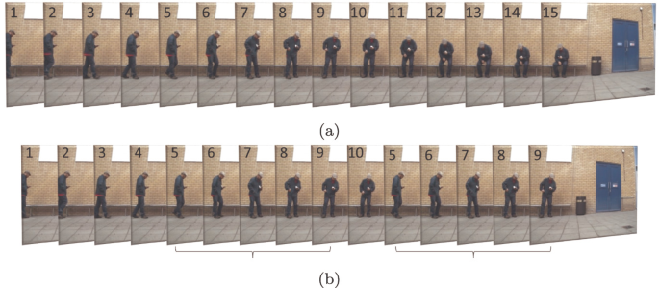
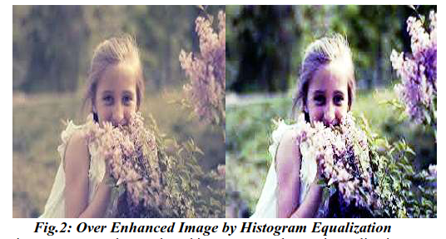
Literature Review > Problem with Histogram Equalization
The process involves merging two or more less frequently occurring neighboring grey levels with highly frequent neighboring grey levels, thereby stretching the entire grey level range.
Mean Shift Problem
Over-Enhancement
It fails to preserve the mean intensity of the input image, a challenge known as the mean shift problem. This limitation can lead to undesirable visual degradation, particularly in the context of video sequences.
Lacks a mechanism to control the level of enhancement [1]

Slide 11
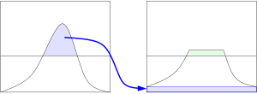
Literature Review > Contrast Limited Adaptive Histogram Equalization
Clahe
CLAHE is a robust method for enhancing local image details, but it occasionally encounters issues related to noise enhancement and excessive contrast stretching.

Slide 12
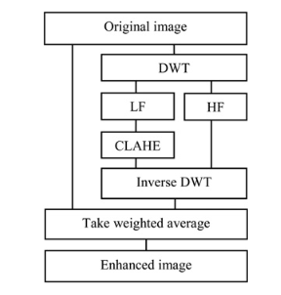
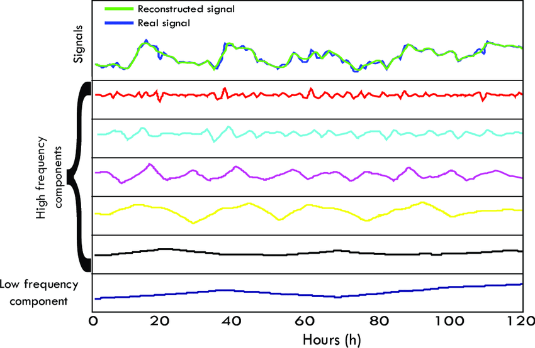
Literature Review > CLAHE-discrete wavelet transform (DWT)
High-frequency component corresponds to the detail information and contains most noises of original image.
Addresses CLAHE issue of noise enhancement.

Slide 13
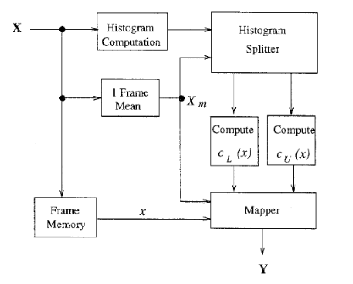
Literature Review>Brightness Preserving Bi-Histogram Equalization (BBHE)
To address the concern of preserving mean brightness, we can split the image into X_L and X_U based on avg intensity value and do HE separately before merging. This ensures that output image intensity is between mid intensity and input image average intensity.
Addresses Mean Shift

Slide 14
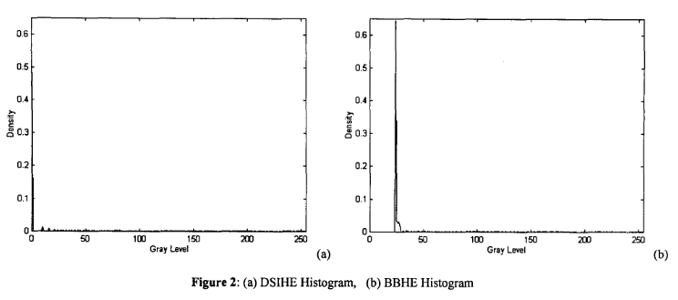
Literature Review > Image enhancement based on equal area dualistic sub-image histogram equalization method (DSIHE)
Addresses Mean Shift
→ Similar to BBHE but divides based on median value since mean is often not robust.
→ Claims that it preserves mean brightness and an image’s average information content (entropy) better than BBHE.

Slide 15
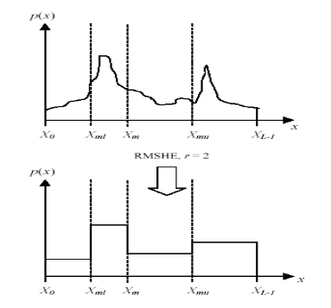
Literature Review > Recursive Mean-Separate Histogram Equalization
Each sub-histogram is divided further into two sub-histograms recursively on the basis of the mean intensity of each sub-histogram. This process repeats until the optimal enhancement is achieved. Optimal enhancement is how close output image’s mean intensity is input image’s mean intensity.
Addresses Mean Shift
→ Generalization of BBHE
→ 2^n sub-histogram

Slide 16
Literature Review > Recursive Sub-Image Histogram Equalization
Each sub-histogram is divided further into two sub-histograms recursively on the basis of the median intensity of each sub-histogram. This process repeats until the optimal enhancement is achieved. Optimal enhancement is how close output image’s mean intensity is input image’s mean intensity.
Addresses Mean Shift
→ Generalization of DSIHE
But 2^n sub-histogram

Slide 17
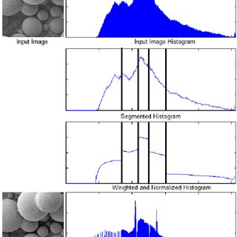
Literature Review > High-Speed Quantile-based Histogram Equalisation
To reduce these drawbacks (such as mean shift problem, and recursive segmentation of the histogram.
→ It divides the histogram based on quantile without using recursive segmentation
→ Then on each sub-histogram apply the histogram equalization
Addresses Mean Shift
Addresses Recursion

Slide 18
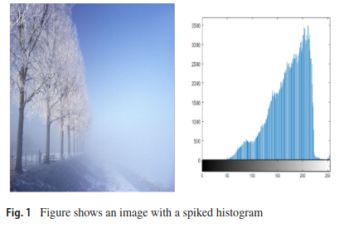
Literature Review > Summary 1
→ Preserve the mean brightness of the image up to a certain level.
→ But these methods do not work very well for images having spikes in the intensity histogram.
Spikes appear in the histogram mainly due to the smooth regions in the image.

Slide 19
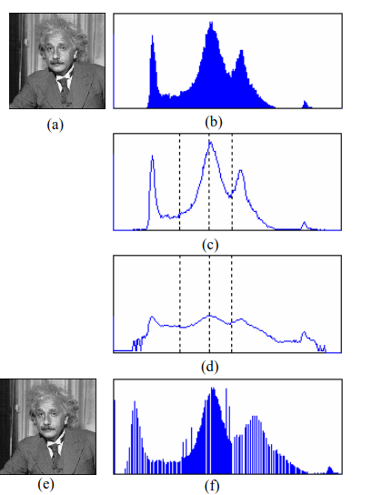
Literature Review > Recursively Separated and Weighted HE
Assigns a slightly larger weight to less frequent grey levels and a slightly lower weight to more frequent grey levels in accordance with the power law function.
Preserves Brightness
The main benefit is that it preserves image brightness while enhancing image contrast. This method also uses recursive process to divide the histogram.

Slide 20
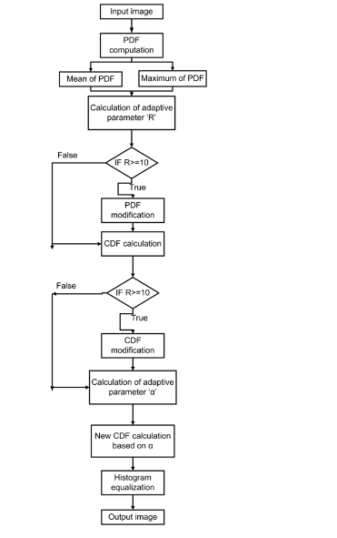
Literature Review > Adaptive Gamma Correction with Weighting Distribu-
tion
→ Same as before
→ Adaptive gamma correction with weighting distribution in place of power law function.
Preserves Brightness
If the input image does not have enough bright pixels, it cannot produce good results

Slide 21
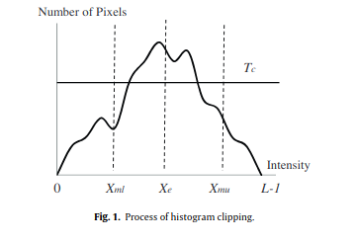
Literature Review > Clipping
The idea behind the histogram clipping is to control the enhancement rate consequently to result preserve brightness.
Tc = median[h(k)]
There are many papers on this approach. We will demonstrate one - MMSICHE divides the histogram into sub-histograms based on median and mean values, applies a clipping threshold for enhancement control, and combines the equalized sub-histograms.
Preserves Brightness

Slide 22
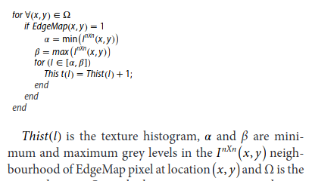
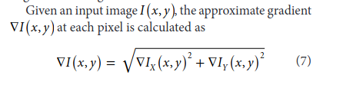

Literature Review > Texture information
These methods are inspired by the idea that the texture regions in an image contain high-density edges, hence considers the neighbourhood of significant edges in histogram computation
Natural Look
In Contrast-enhancement via texture region-based HE, the histogram of the input image is generated by taking into account its texture information. Specifically, the texture information is extracted from the image and used to determine the distribution of pixel intensities

Slide 23
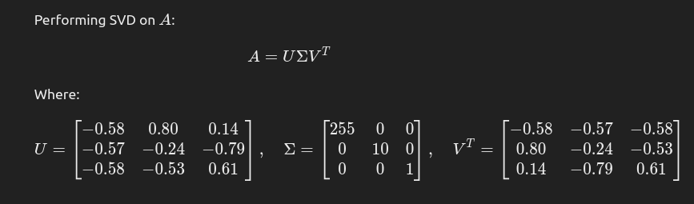
Literature Review > Enhancement using Discrete wavelet transform and SVD
They argue that the real contrast of an image is determined by both its local and global contrasts.
Breaking down the image into different frequency components using Discrete Wavelet Transform (DWT).
Focusing on the low-frequency (low–low) subband, which contains most of the image’s structural and intensity information.
Improving this subband using Singular Value Decomposition (SVD), a mathematical method that manipulates the image's singular values to enhance its features.

Slide 24
Literature Review > Enhancement using Discrete wavelet transform and SVD
They argue that the real contrast of an image is determined by both its local and global contrasts.
Breaking down the image into different frequency components using Discrete Wavelet Transform (DWT).
Focusing on the low-frequency (low–low) subband, which contains most of the image’s structural and intensity information.
Improving this subband using Singular Value Decomposition (SVD), a mathematical method that manipulates the image's singular values to enhance its features.
Natural Look

Slide 25
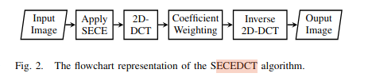
Literature Review > Spatial entropy-based global and local image contrast enhancement
They argue that the real contrast of an image is determined by both its local and global contrasts.
Global Enhancement using SECE: The spatial distribution of a grey level is used to obtain a function which is further mapped to a uniform distribution to achieve contrast enhancement, preserving natural look.
Natural Look
2. Local Enhancement using Weighting on low-band: By applying 2D-DCT in a block-wise manner, the local contrast is improved,

Slide 26
Literature Review > Research Gap
Preserving complete information of image during contrast enhancement
A better representation of grey pixels so that they contain more information (local and global)
Lightweight approach
The proposed entropy curve-based contrast enhancement technique exploits the complete information associated with the grey level and is hence able to achieve better contrast without enhancing noise and artifacts in the resultant image.

Slide 27
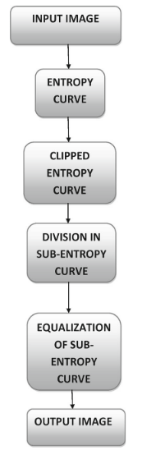
Methodology

Slide 28
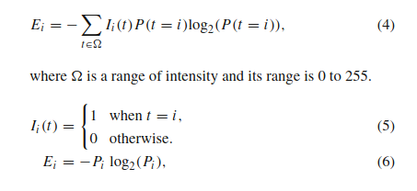
Methodology > Entropy Curve
E_{i} is the information associated with the ith grey level. In order to obtain the entropy curve, we plot E_{i} values against the ith grey level.
P(X) represents the probability that a pixel take the grey-level X.

Slide 29
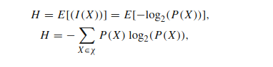
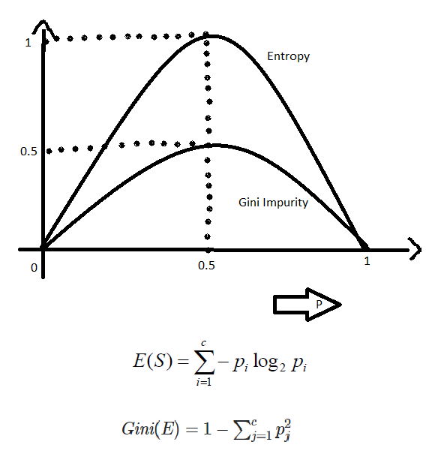
Methodology > Entropy Curve
E i is the information associated with the ith grey level. In order to obtain the entropy curve, we plot E i values against the ith grey level.
P(X) represents the probability that a pixel take the grey-level X.

Slide 30
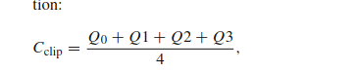
Methodology > Clipped Entropy Curve
To Control the enhancement level at extreme grey levels (dark or bright regions) we use the clipping criteria in the entropy curve.

Slide 31
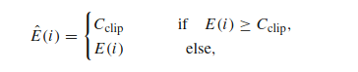
Methodology > Division in Sub-Entropy Curve
To Control the enhancement level at extreme grey levels (dark or bright regions) we use the clipping criteria in the entropy curve.

Slide 32
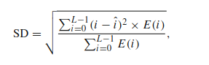
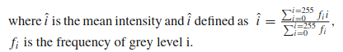
Methodology > Division in Sub-Entropy Curve
To Control the enhancement level at extreme grey levels (dark or bright regions) we use the clipping criteria in the entropy curve.

Slide 33
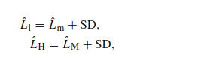
Methodology > Division in Sub-Entropy Curve
To Control the enhancement level at extreme grey levels (dark or bright regions) we use the clipping criteria in the entropy curve.
L_{m} and L_{M} represent grey levels corresponding to minimum and maximum entropy levels of the clipped entropy
curve (E), respectively. The entropy curve is divided into threes sub-regions based on these two values.

Slide 34
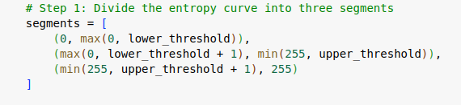
Methodology > Division in Sub-Entropy Curve
To Control the enhancement level at extreme grey levels (dark or bright regions) we use the clipping criteria in the entropy curve.
The Three Sub-Regions
L_{l}
L_{H}
Adaptive < N sub-region
Because adaptive focuses on very small region that can amplify noise.

Slide 35
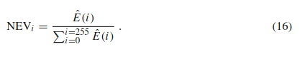
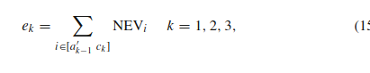
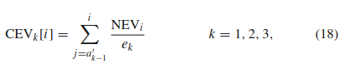
Methodology > Entropy curve equalization
We do normalization using the following steps now.

Slide 36
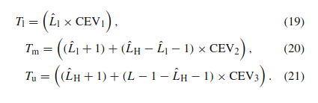
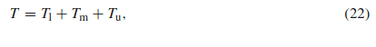
Methodology > Entropy curve equalization
Each of the 3 segments is equalized using cumulative entropy values (CEV).

Slide 37
Methodology > Summary

Slide 38
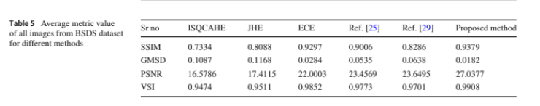
Evaluation
kagglehub.dataset_download("balraj98/berkeley-segmentation-dataset-500-bsds500")
version | PSNR | RMSE
Histogram Equalization | 16.77 | 41.5
V2 | 24.94 | 17.55
V3 | 25.37 | 16.93
V4 | 25.53 | 16.43

Slide 39
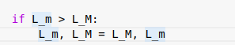
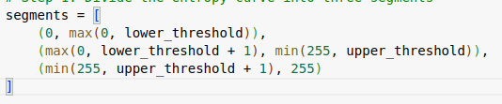
Implementation
V2 | 24.94 | 17.55
V3 | 25.37 | 16.93
V4 | 25.53 | 16.43
https://colab.research.google.com/drive/1K3n4h2lot1UGLY_jwQ8PdIzSzxw-gI65?usp=sharing

Slide 40
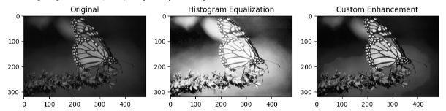
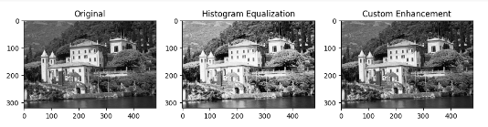
Sample Image

Slide 41
Novelty
Theoretical
Application

Slide 42
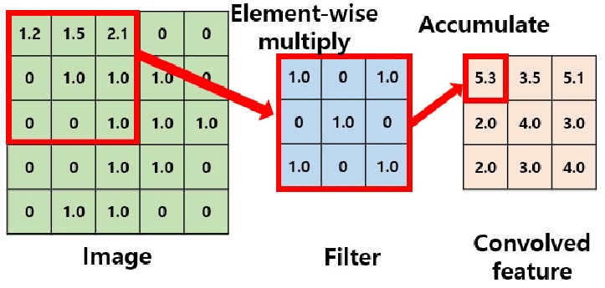
Novelty > Theoretical > Adaptive
"balraj98/berkeley-segmentation-dataset-500-bsds500"
version | PSNR | RMSE
Histogram Equalization | 16.77 | 41.5
V2 | 24.94 | 17.55
V3 | 25.37 | 16.93
V4 | 25.53 | 16.43
Adaptive v1 | 6.3 | 124.4

Slide 43
Novelty > Theoretical > Adaptive
"balraj98/berkeley-segmentation-dataset-500-bsds500"
version | PSNR | RMSE
Histogram Equalization | 16.77 | 41.5
V2 | 24.94 | 17.55
V3 | 25.37 | 16.93
V4 | 25.53 | 16.43
Adaptive v1 | 6.3 | 124.4

Slide 44
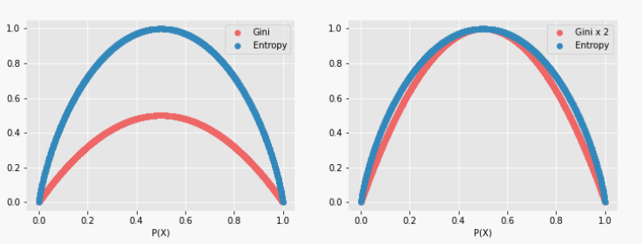
Novelty > Theoretical > Gini Index
But Faster!
Similar Curve

Slide 45
Novelty > Theoretical > Gini Index > Faster (DRAFT!)
Algorithm | Time | Dataset
V4 | 6.45 | BSDS (N=200)
Gini v1 | 4.26 | BSDS (N=200)
V4 | 49.61 | UIEBR (N=890)
Gini v1 | 46.96 | UIEBR (N=890)
"balraj98/berkeley-segmentation-dataset-500-bsds500"
https://li-chongyi.github.io/proj_benchmark.html
Conclusion: The Gini-based algorithm (Gini v1) is computationally faster than Entropy Curve V4 across both datasets.

Slide 46
Novelty > Theoretical > Gini Index > Accuracy
"balraj98/berkeley-segmentation-dataset-500-bsds500"
Algorithm | Time | PSNR | RMSE | Dataset
V4 | 6.45 | 25.53 | 16.43 | BSDS (N=200)
Gini v1 | 4.26 | 21.64 | 22.65 | BSDS (N=200)
Gini v2 | 3.88 | 21.21 | 23.14 | BSDS (N=200)
Gini v3 p*(1-p) | 3.82 | 21.48 | 22.95 | BSDS (N=200)
Gini v4 (nonlinear scaling) | 3.72 | 24.44 | 16.55 | BSDS (N=200)
Gini v5 (image add) | 4.25 | 28.87 | 9.93 | BSDS (N=200)

Slide 47
Novelty > Theoretical > Changes
> Approximating Entropy Curve: Square Gini Index curve to approximate entropy curve.
> Minimum Clipping: A minimum threshold for Gini values to ensure segments with low Gini values do not dominate
> Non-Linear Scaling: Use a non-linear scaling function that emphasizes contrast in segments.
> Preserve Naturalness: If the enhanced image appears overly processed, incorporate a blending step: We blend the enhanced image with the original.

Slide 48



Novelty > Theoretical
Gini is Faster!
Our Gini is more “Accurate” !
Started draft paper writing. Urgent need of guidance.

Slide 49
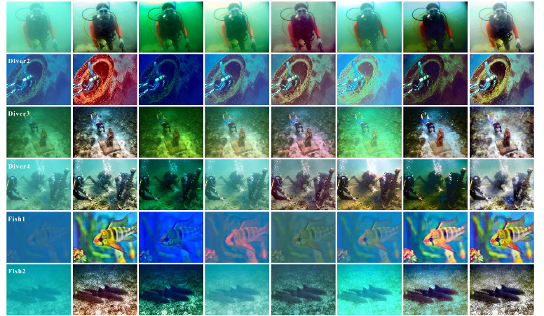
Novelty > Application
Underwater Image Enhancement

Slide 50
Novelty > Application > Result
Evaluates the perceptual quality, focusing on contrast enhancement.
version | PSNR | RMSE | EI | PCQI
This Paper | 22.07 | 23.10 | 59.80 | 0.05
Dataset Paper | - | - | 90.13 | 1.101
Poor perceptual contrast, possibly oversaturated or degraded image).
Dataset used in Paper: “Color correction and adaptive contrast enhancement for underwater image enhancement”

Slide 51
Conclusion
5+ major revisions to reproduce the paper’s method
3 Novelty (Required 5+2 major revisions as well)
Understanding Vast Literature was intriguing

Slide 52
Conclusion
Thanks a lot for your time. Feel free to ask any questions…

Slide 53
Conclusion
[1] Raheja, Anisha, et al. "Controlling over enhancement of images using histogram equalization technique." IOP Conference Series: Materials Science and Engineering. Vol. 804. No. 1. IOP Publishing, 2020.

